Slide 1

HTML PROJECT
20XX
Name: Ankur Sangwan
Section : K22GH
Roll No. 19

Slide 2
About Website
20XX
This website is made by my group. This website we have made using basic HTML and CSS. We have created three webpages and linked them to our university site and their social accounts.
It will be providing basic knowledge about our university and our School of Computer Science and Engineering.

Slide 3
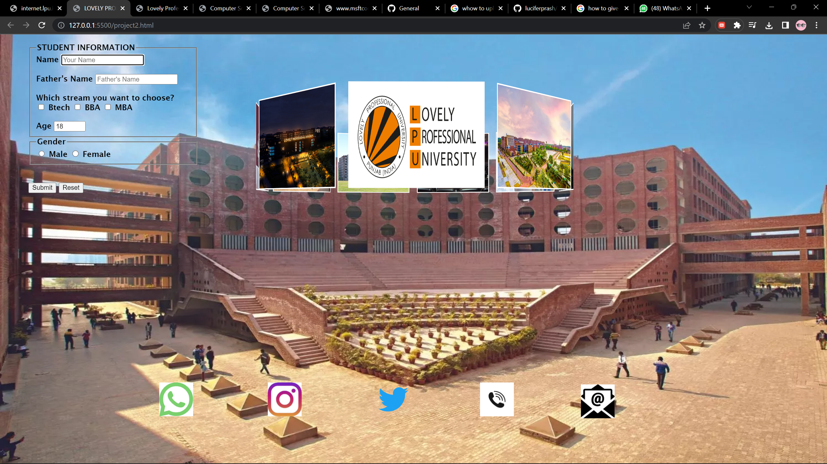
Use of Slide Show

Slide 4
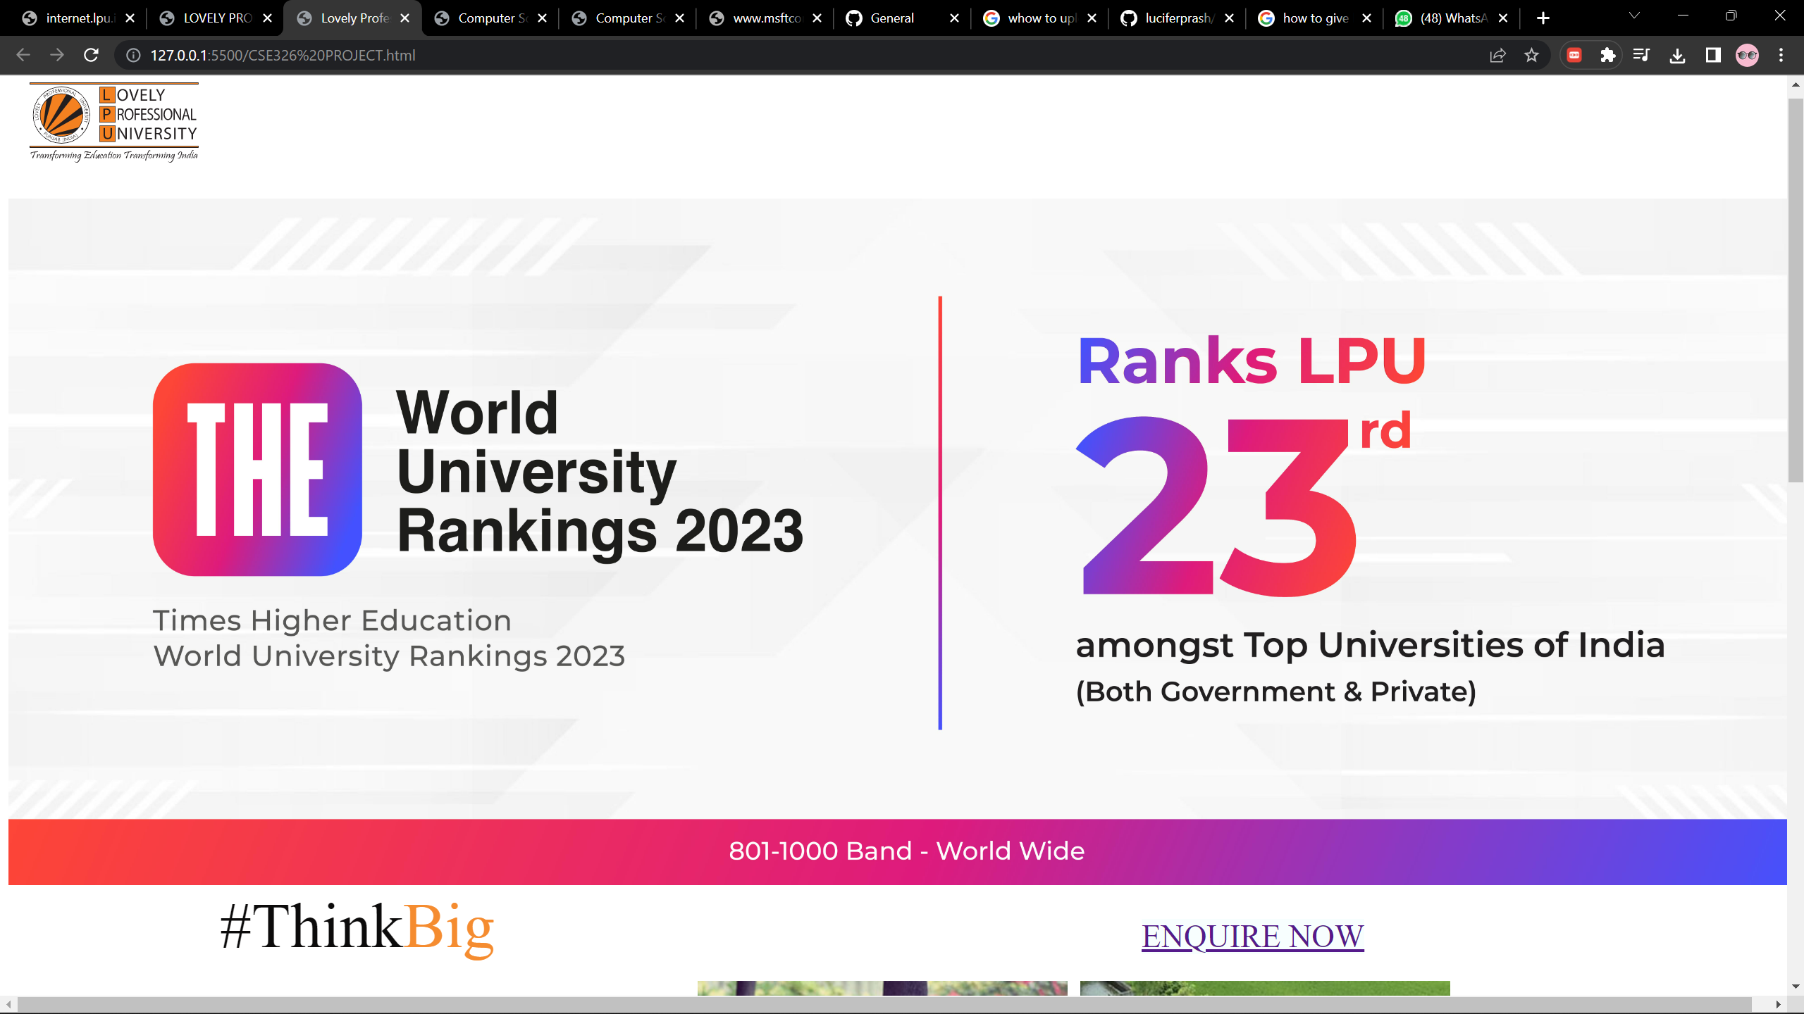
Cover Page

Slide 5
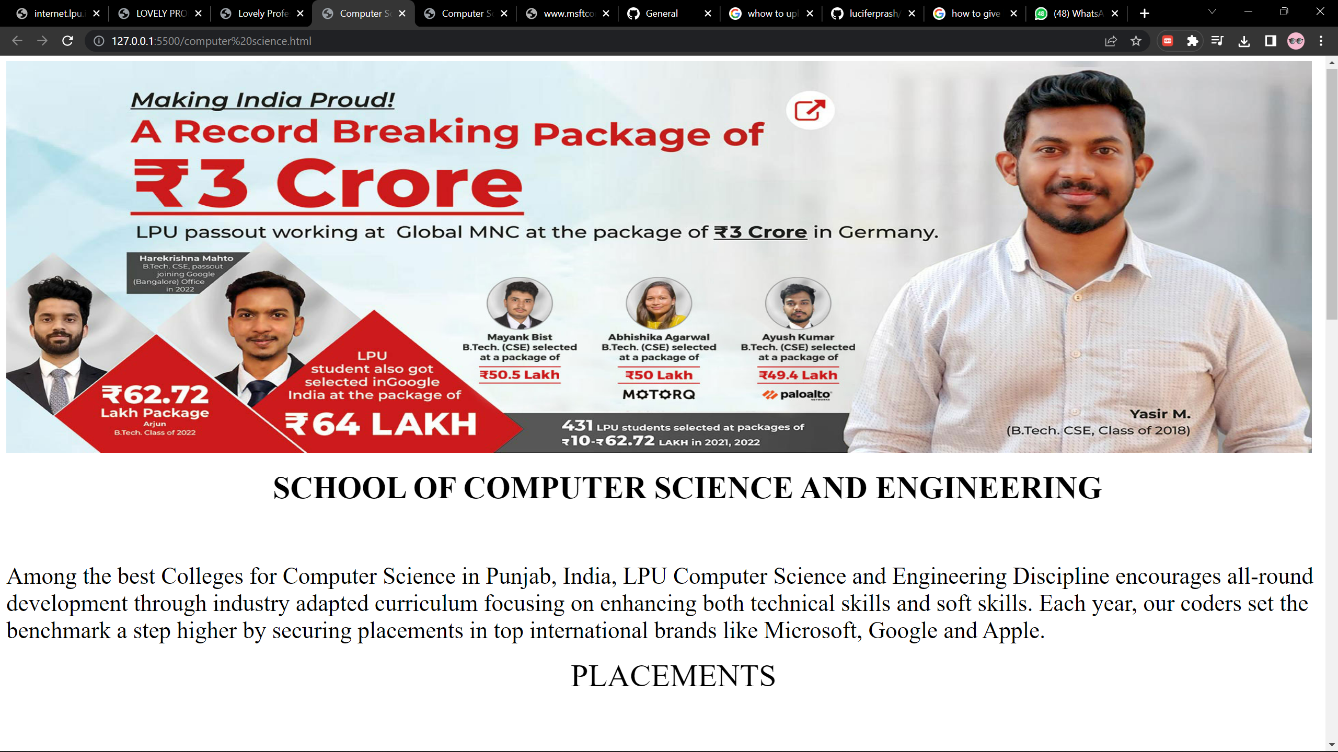
School Web Page

Slide 6


Important Links
https://github.com/18ankur/Lpu-webpage/upload/main
https://github.com/18ankur

